Slide 1
Computer Networks I Error Detection (Parity check and Internet checksum)
Amitangshu Pal
Computer Science and Engineering
IIT Kanpur

Slide 2
Types of Errors
An error occurs when a bit is altered between transmission and reception
Types of errors:
Single bit errors
Burst errors

Slide 3
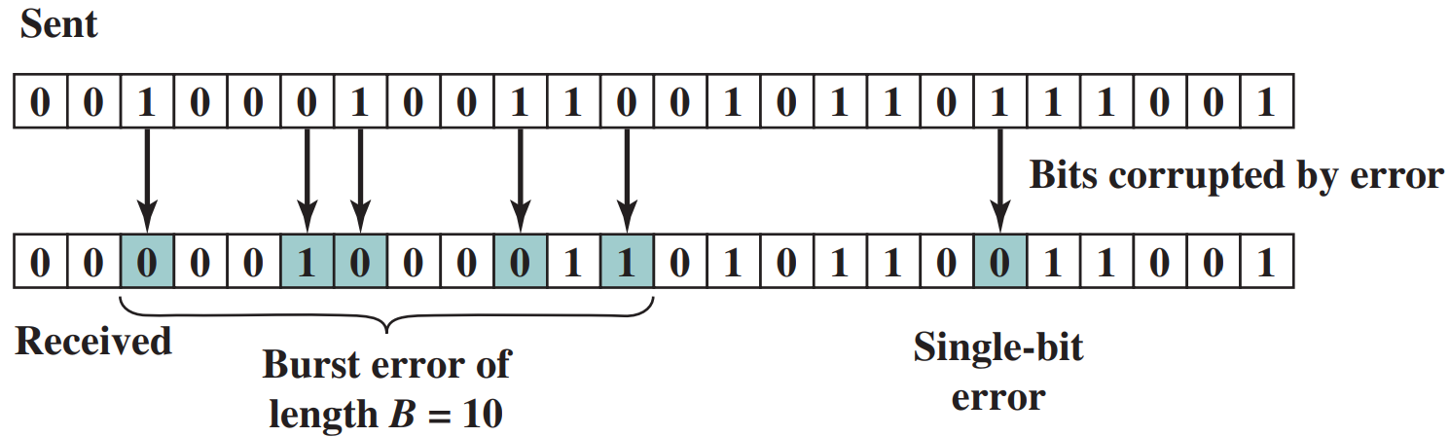
Types of Errors
Single bit error:
Isolated error that alters one bit but does not affect nearby bits
Can occur in presence of white noise

Slide 4
Types of Errors
Burst error:
Contiguous sequence of B bits in which the first and last bits and any number of intermediate bits are received in error
Can occur due to impulse noise or fading in wireless environment
Effects are greater at higher data rates

Slide 5
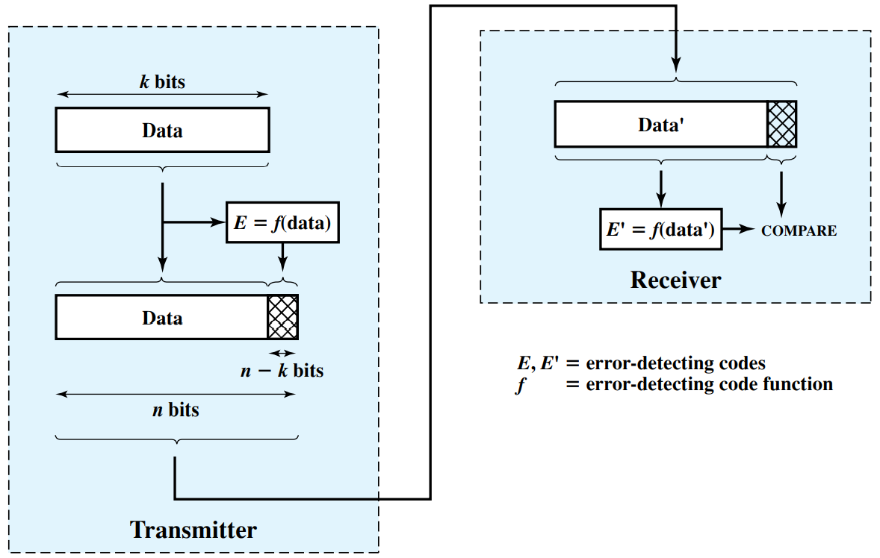
Error Detection

Slide 6
Error Detection
Error detection
Parity check
Internet checksum
Cyclic redundancy check
Notes:
Let me first give a brief introduction of WOBAN architecture and the motivation of using WOBAN as an access technology. There are two main types of popular access networks. 1. Optical access networks where from CO optical fibers are pulled to ONUs located at every homes, premises or offices, which basically work as gateways for Internet access to the users. The popular access technology of this access networks is PON. The advantage of this access is that it provides high bandwidth and fast Internet service. The limitation is that it needs fiber to penetrate in each and every premises which make this scheme very costly. Also there is a limitation of maximum fiber length.
Another popular access networks is wireless access. Popular technology of this type are WiFi and WiMAX. The advantage of these access technology is that this is flexible and cost effective scheme. But the limitation is that when the hop of hops increase a lot, real time multi-media traffic suffers a lot.
Let me first give a brief introduction of WOBAN architecture and the motivation of using WOBAN as an access technology. There are two main types of popular access networks. First is the optical access such as passive optical networks (PON), which provides fast Internet service because of high bandwidth. But it requires fiber to be penetrated from central office to all residential complex, offices and premises which make the scheme highly costly. Another popular access technology is wireless access, which is flexible and cost-efficient, but does not function well when the number of hops increases.

Slide 7
Parity Check
The simplest error detecting scheme is to append a parity bit to the end of a block of data
Even parity: Total number of ones will be even
Odd parity: Total number of ones will be odd
Any odd number of bit errors is detected

Slide 8
Parity Check
Limitation: If any even number of bits are inverted due to error, an undetected error occurs

Slide 9
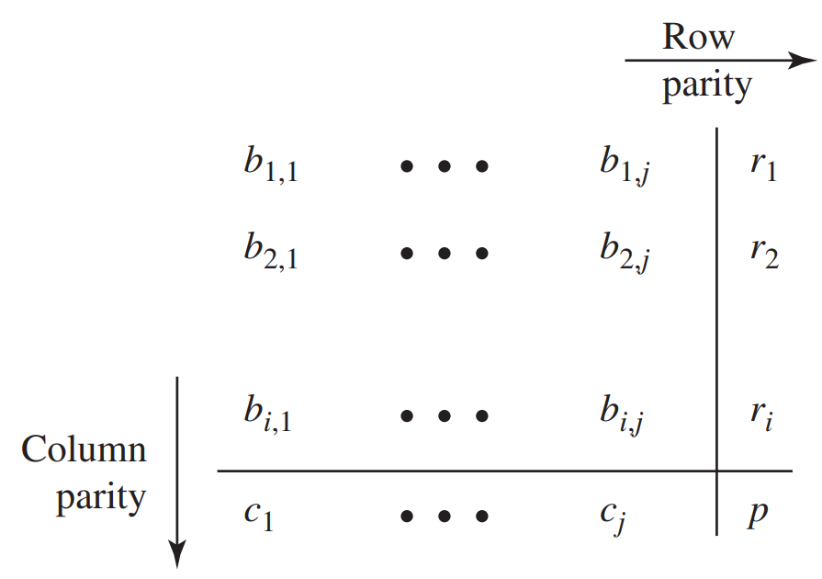
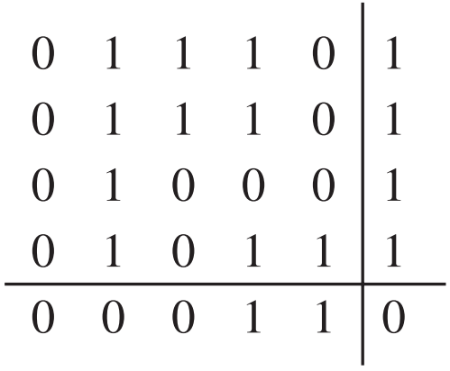
Two-dimensional Parity Check
01110 01110 01000 01011
011101 011101 010001 010111 000110

Slide 10
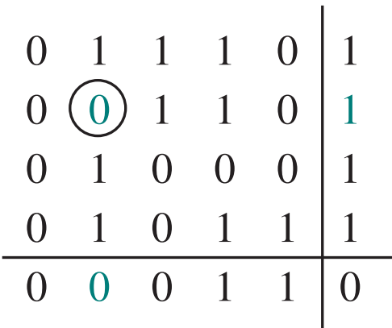
Two-dimensional Parity Check
A single-bit error is detected and corrected
Any odd number of bit errors is detected
Some even number of bit errors is also detected

Slide 11
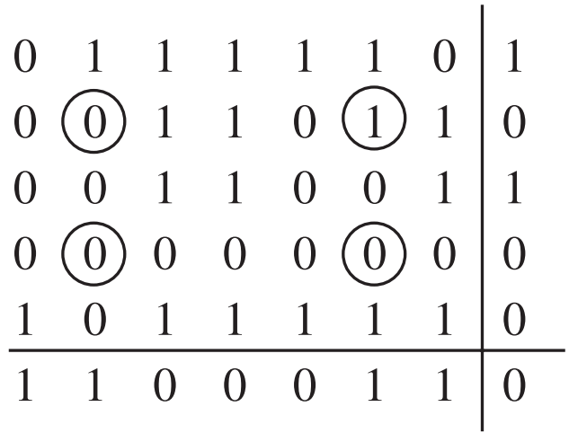
Two-dimensional Parity Check
Any pattern of four errors forming a rectangle is undetectable

Slide 12
The Internet Checksum
Ones-complement operation:
Replace 0 with 1, and 1 with 0

Slide 13
The Internet Checksum
Ones-complement addition:
The two numbers are treated as unsigned binary integers and added
If there is a carry out of the leftmost bit, add 1 to the sum (end-around carry)

Slide 14
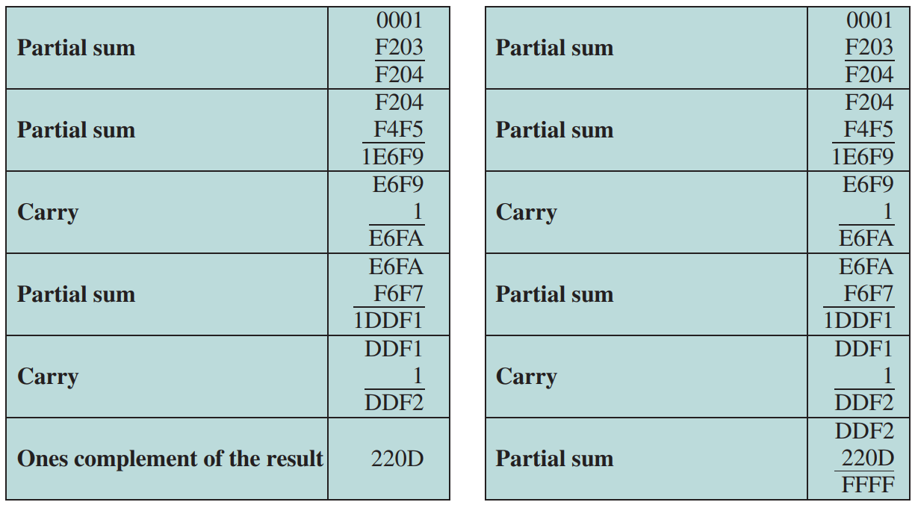
The Internet Checksum
00 01 F2 03 F4 F5 F6 F7 00 00

Slide 15
The Internet Checksum
Provides better greater error detection capability than parity check
Provides weak protection
1 1 1 0 0 1 1 0 0 1 1 0 0 1 1 0
0 1
1 1 0 1 0 1 0 1 0 1 0 1 0 1 0 1
1 0
wraparound
1 1 0 1 1 1 0 1 1 1 0 1 1 1 0 1 1
sum
1 0 1 1 1 0 1 1 1 0 1 1 1 1 0 0
checksum
0 1 0 0 0 1 0 0 0 1 0 0 0 0 1 1

Slide 16
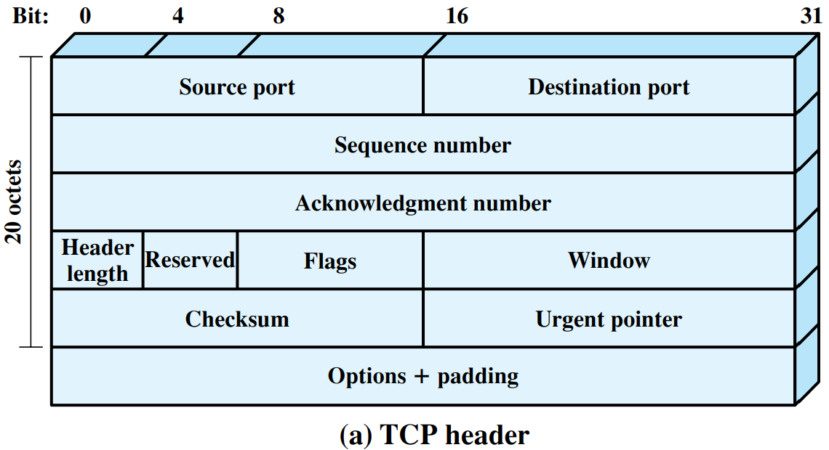
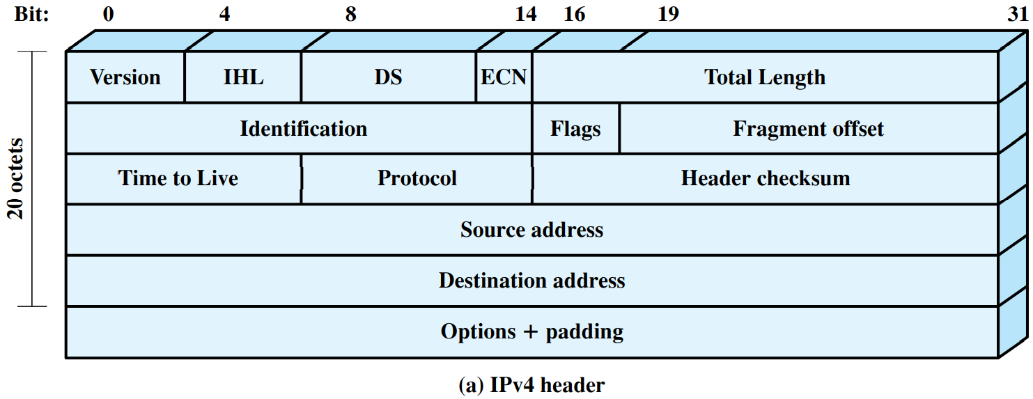
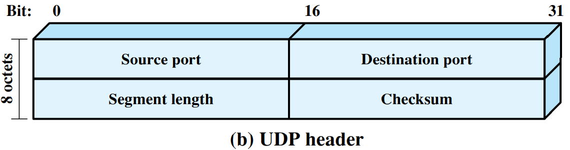
The Internet Checksum
Internet checksum is used in many Internet standard protocols, including IP, TCP, and UDP

Slide 17
Summary
Different error detection techniques discussed:
Parity check
Internet checksum

